Slide 1
Europa Wisegate

Slide 2
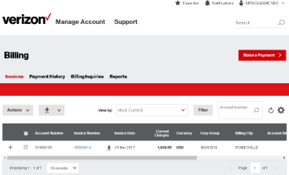
Problem
3K
WG
Avg. of daily Batch updates
+4M
New Invoices Monthly
VEC 2.0
VAM

Slide 3
Solution
Migration of entitlement information from Oracle into Neo4j.
Implement event-driven architecture for entitlement operations so modules interested can react accordingly.

Slide 4
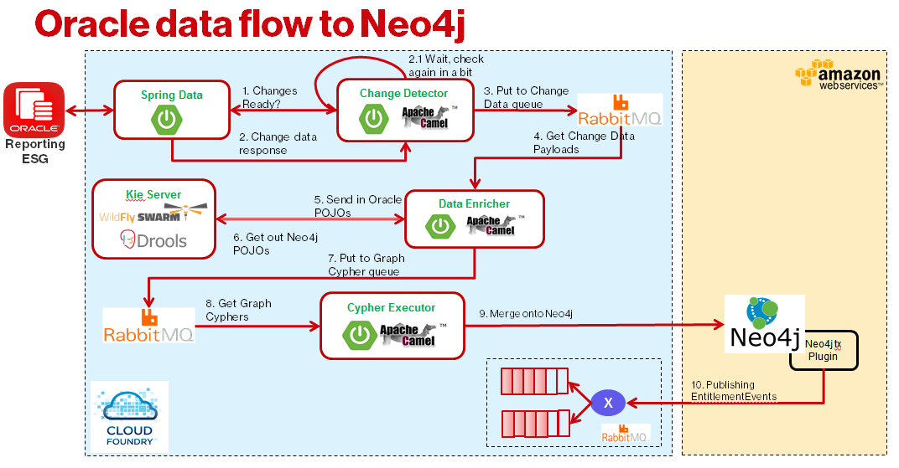

Slide 5
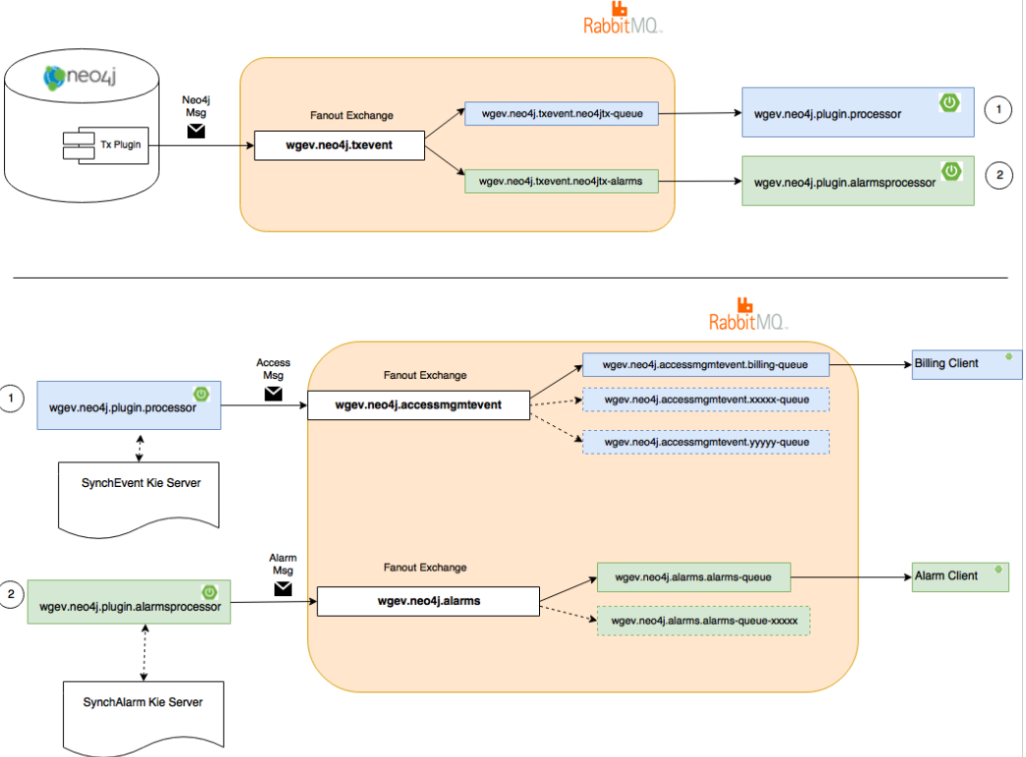

Slide 6
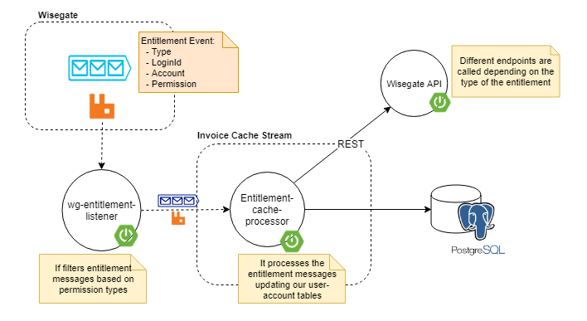
Integration with Billing

